Slide 1




Part of
Brazilian E-Commerce Data Analysis and Prediction
Integrated Program in Business Analytics(IPBA)
Final Capstone Project Showcase
Presented by-
- Alekya Avula
- Saurabh Purty
- Alpesh Gorde
- Manoj Gunda
- Arun Kumar
- Jatin Labhi

Slide 2

Part of
Outline
1.
Summary
2.
Problem Statement
3.
Data Understanding and Merging
Data Cleaning
Exploratory Data Analysis(EDA)
4.
Conclusion
5.
© 2021 Jigsaw Academy Education Pvt Ltd.

Slide 3
Part of
Summary
Welcome! The analysis which is presented in upcoming slides is done in Jupyter notebook is a part of IIM Indore’s IPBA program BYOP projects.
We have used Brazilian e-commerce public dataset of orders made at Olist Store.
The dataset has information of 100k orders from 2016 to 2018 made at multiple marketplaces in Brazil.
Its features allows viewing an order from multiple dimensions: from order status, price, payment and freight performance to customer location and product attributes.
© 2021 Jigsaw Academy Education Pvt Ltd.

Slide 4
Part of
Problem Statement
In this project we have tried to find-out some insights from the e-commerce dataset:
1. How e-commerce has evolved over time in Brazil?
2. Highest Monthly sales over 3 years?
3. On what days of week Brazilians customers tend to do online shopping?
4. Which are top 10 categories?
5. What is average price of top 10 categories?
6. How many payment methods are available? and which one is the most popular?
7. Payment methods vs number of instalments?
8. How customers are distributed over the states?
9. Which state has longest and shortest delivery time?
10. Highest sales for the year 2016, 2017, 2018?
11. Which customer city has the highest and lowest shipping Values?
12. Product category with the highest number of payment instalments?
© 2021 Jigsaw Academy Education Pvt Ltd.

Slide 5
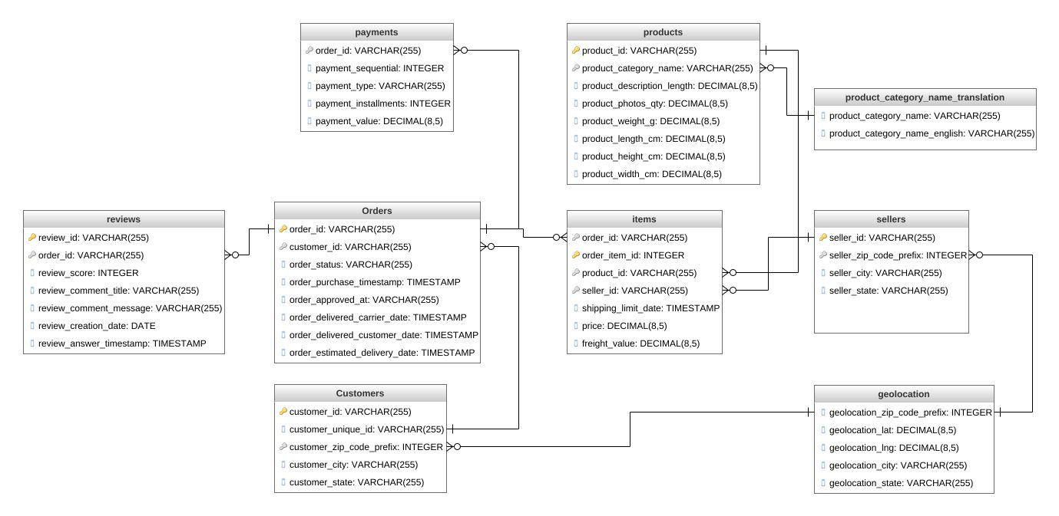
Data Understanding
Part of
There are 8 datasets(in CSV format) with different attributes which are helpful for drawing some useful insights.
Customers Dataset
Order Dataset
Order Payment Dataset
Seller’s Dataset
Product Category Dataset
Geolocation Dataset
Order items dataset
Products Dataset
© 2021 Jigsaw Academy Education Pvt Ltd.

Slide 6
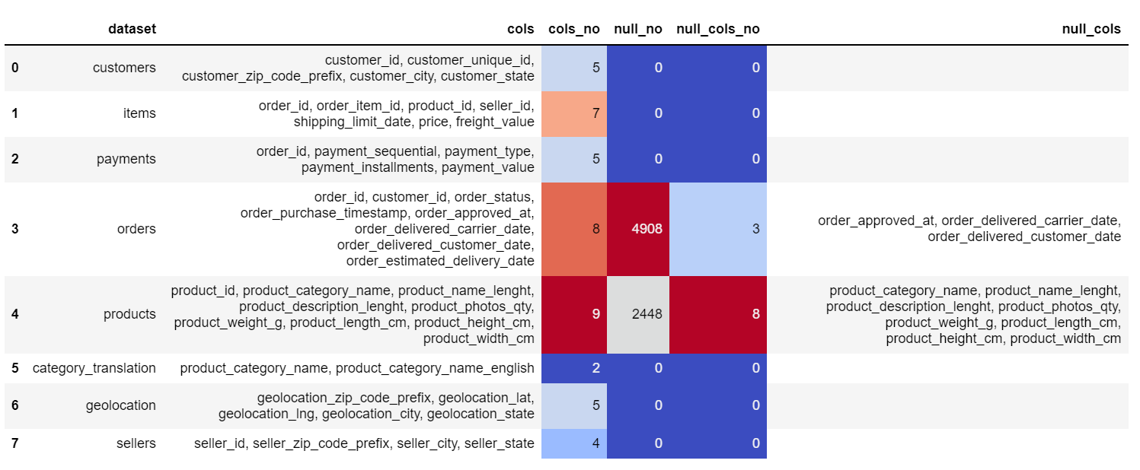
Data Merging and Cleaning
Part of
These Datasets are merged and null values has been identified as follows:
© 2021 Jigsaw Academy Education Pvt Ltd.

Slide 7
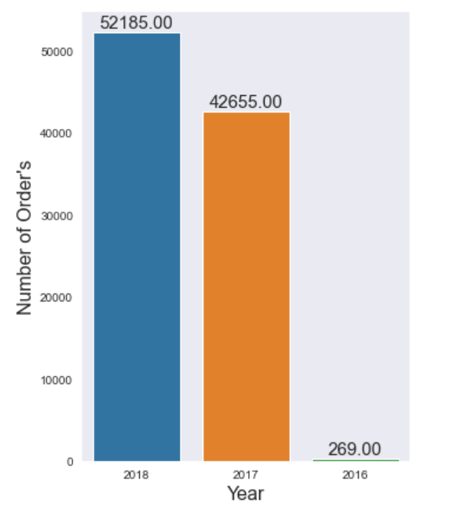
Exploratory Data Analysis
Part of
1. How e-commerce has evolved over time in Brazil?
It can be seen that after 2016 e-commerce in Brazil increased rapidly.
© 2021 Jigsaw Academy Education Pvt Ltd.

Slide 8
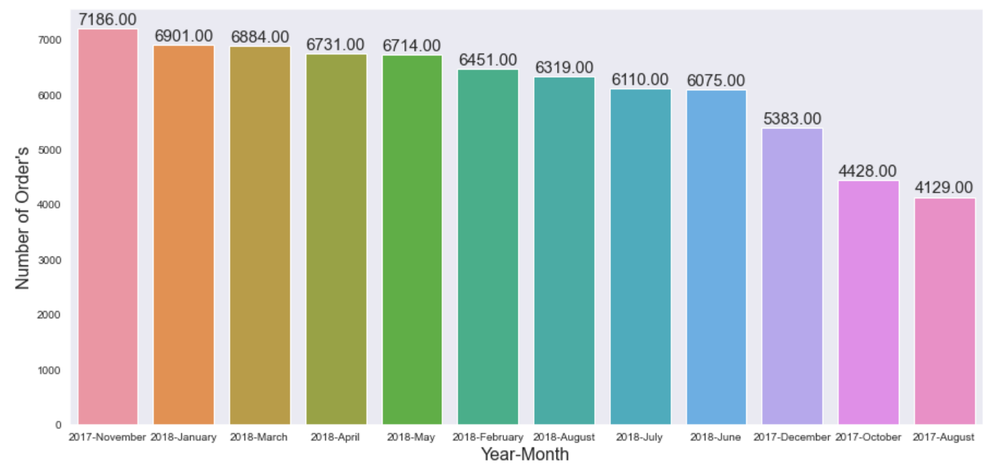
Exploratory Data Analysis
Part of
2. Highest Monthly sales over 3 years?
It can be clearly seen that Nov 2017 is the highest sales months over the period of 3 years.
© 2021 Jigsaw Academy Education Pvt Ltd.

Slide 9
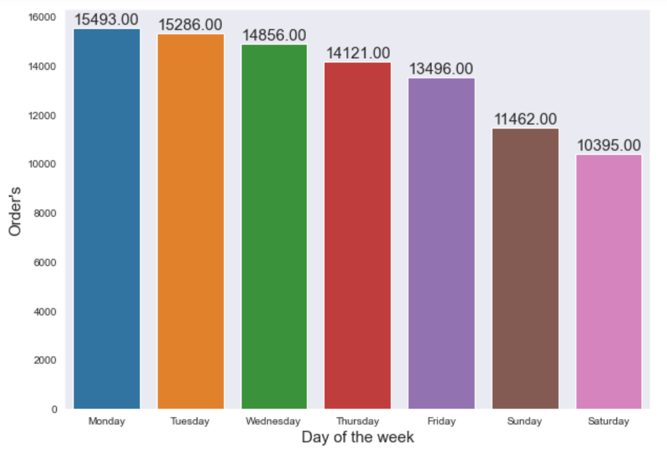
Exploratory Data Analysis
Part of
3. On what days of week Brazilians customers tend to do online shopping?
We can see more online shopping happen on weekdays and less on weekends.
© 2021 Jigsaw Academy Education Pvt Ltd.

Slide 10
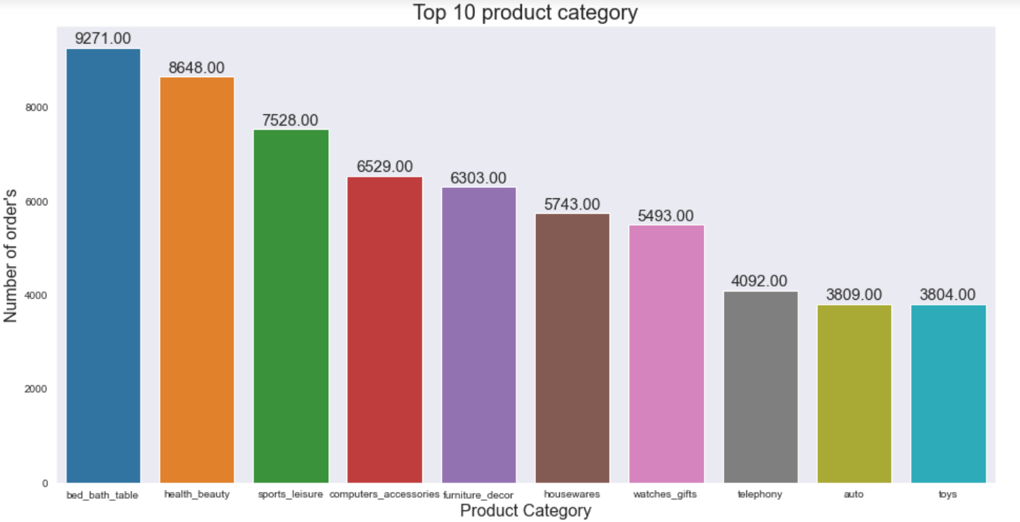
Exploratory Data Analysis
Part of
4. Which are top 10 categories?
Bed_bath_table category is the top selling category.
© 2021 Jigsaw Academy Education Pvt Ltd.

Slide 11
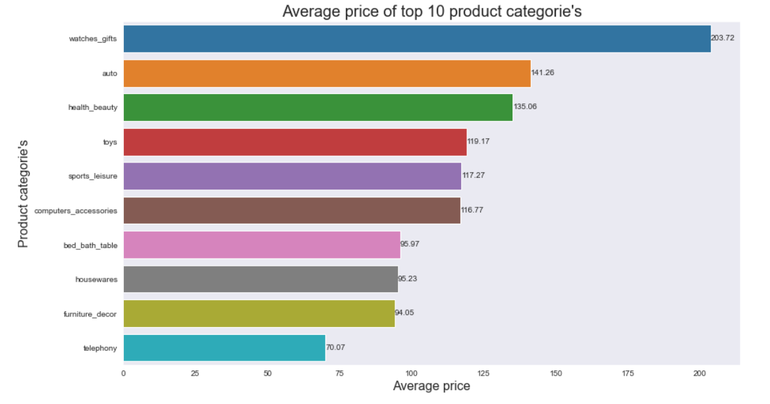
Exploratory Data Analysis
Part of
5. What is average price of top 10 categories?
Watches and gifts is the top product with highest average price
© 2021 Jigsaw Academy Education Pvt Ltd.

Slide 12
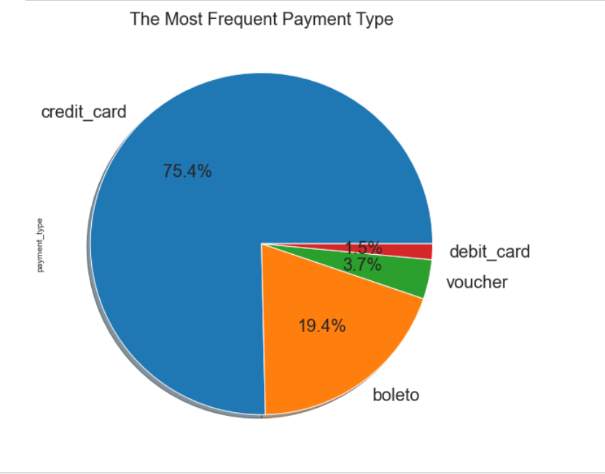
Exploratory Data Analysis
Part of
6. How many payment methods are available? and which one is the most popular?
There are 4 payment types in Brazil with Credit Card solely account of 75 % and it is the most common payment method.
© 2021 Jigsaw Academy Education Pvt Ltd.

Slide 13
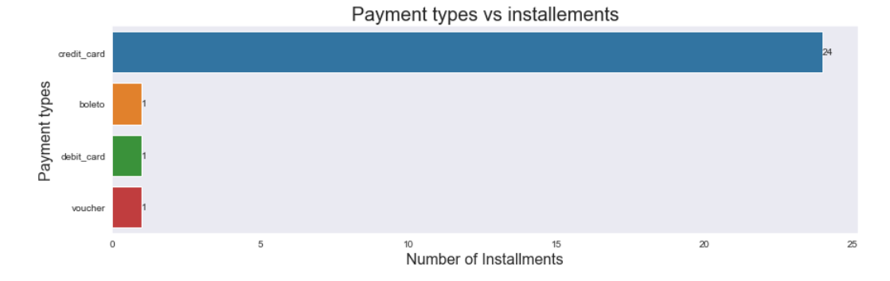
Exploratory Data Analysis
Part of
7. Payment methods vs number of installments
Credit Cards having highest number of Instalments
© 2021 Jigsaw Academy Education Pvt Ltd.

Slide 14
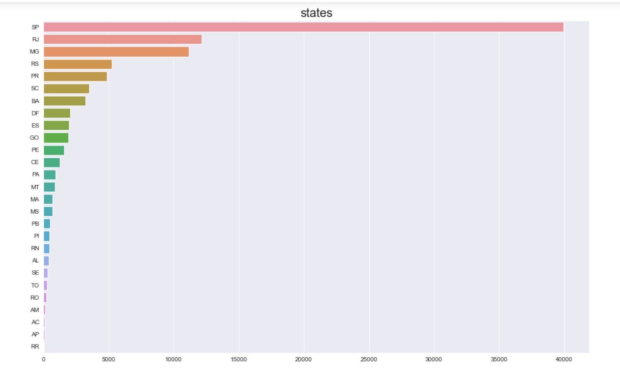
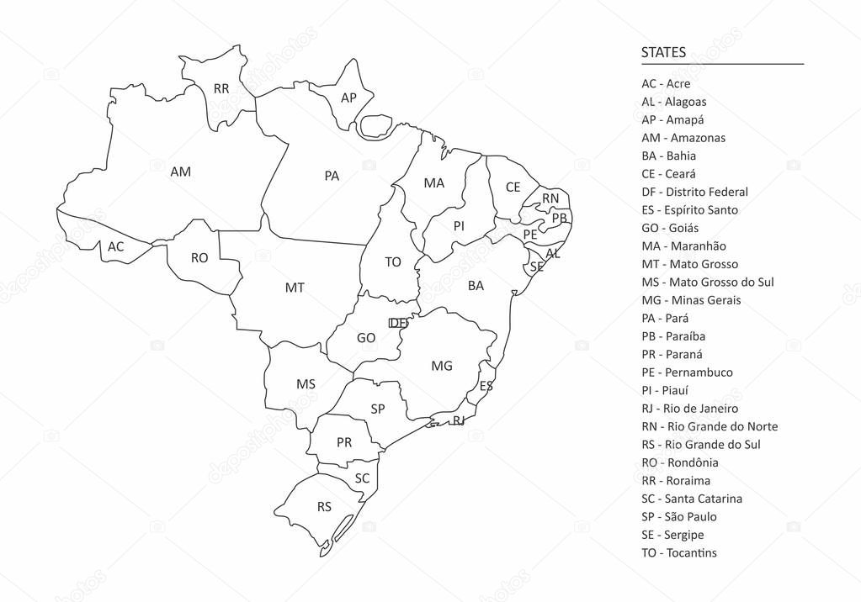
Exploratory Data Analysis
Part of
8. How customers are distributed over the states?
Most customers are from Sao Paulo, followed by Rio de Janeiro.
© 2021 Jigsaw Academy Education Pvt Ltd.

Slide 15
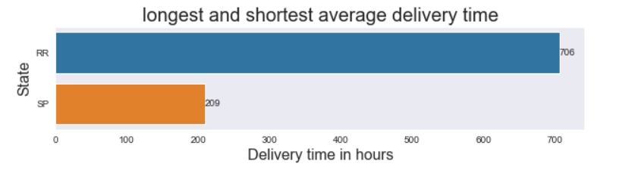
Exploratory Data Analysis
Part of
9. Which state has longest & shortest average delivery time?
The longest and shortest delivery time belongs to the State of Roraima(RR) and Sao Paulo(SP).
© 2021 Jigsaw Academy Education Pvt Ltd.

Slide 16
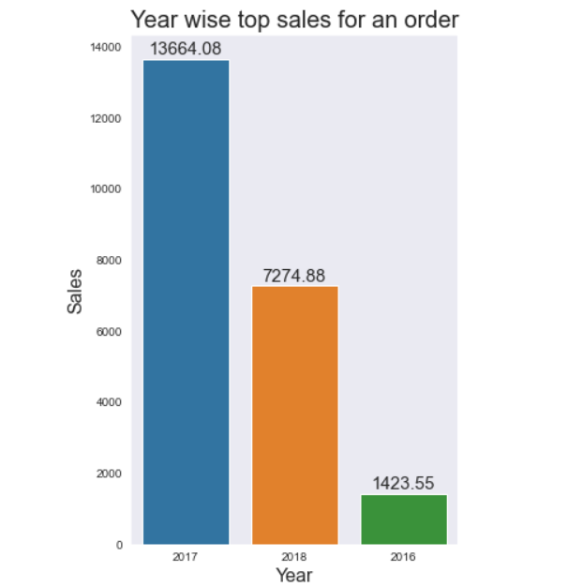
Exploratory Data Analysis
Part of
10. Highest sales for the year 2016, 2017, 2018
2017 year has the highest sales with almost double the amount compared to 2018
© 2021 Jigsaw Academy Education Pvt Ltd.

Slide 17
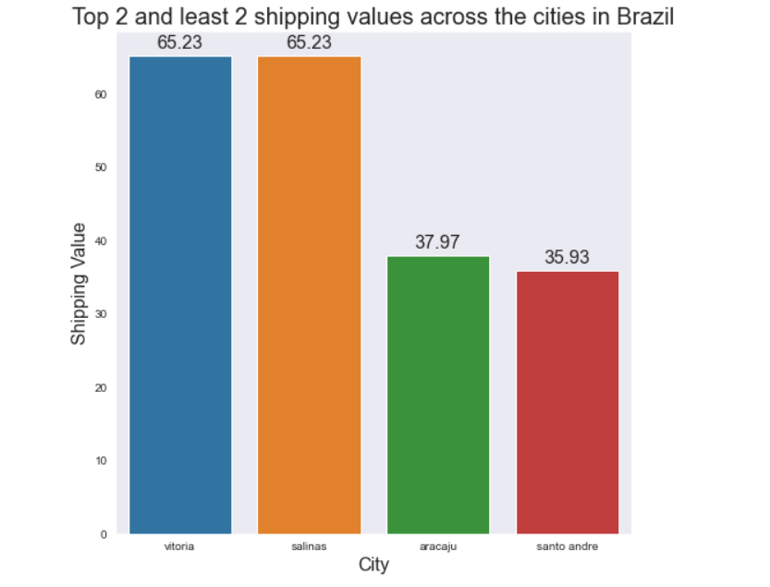
Exploratory Data Analysis
Part of
11. Customer City vs Freight Value
Vitoria and Salinas has the highest shipping value and Santo Andre has the lowest shipping value
© 2021 Jigsaw Academy Education Pvt Ltd.

Slide 18
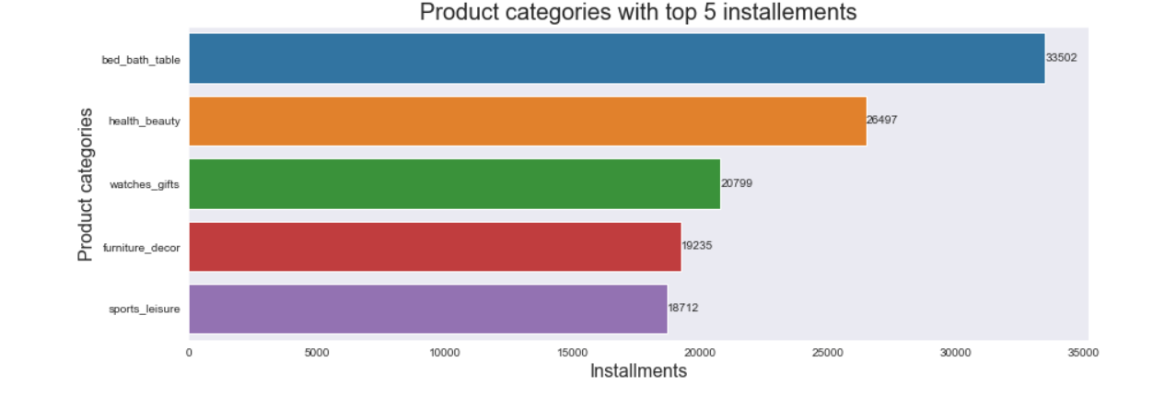
Exploratory Data Analysis
Part of
12. Product category with the highest number of payment instalments
Bed bath table has the highest number of payment instalment.
© 2021 Jigsaw Academy Education Pvt Ltd.

Slide 19
Conclusion
Part of
With these 12 most important and insightful findings of Olist Brazilian e-commerce, further action can be taken to work on weaknesses and improve the service.
© 2021 Jigsaw Academy Education Pvt Ltd.

